Slide 1
Conversations with Kip
Introduction to
Bookkeeping
By Kip M. Twitchell

Slide 2
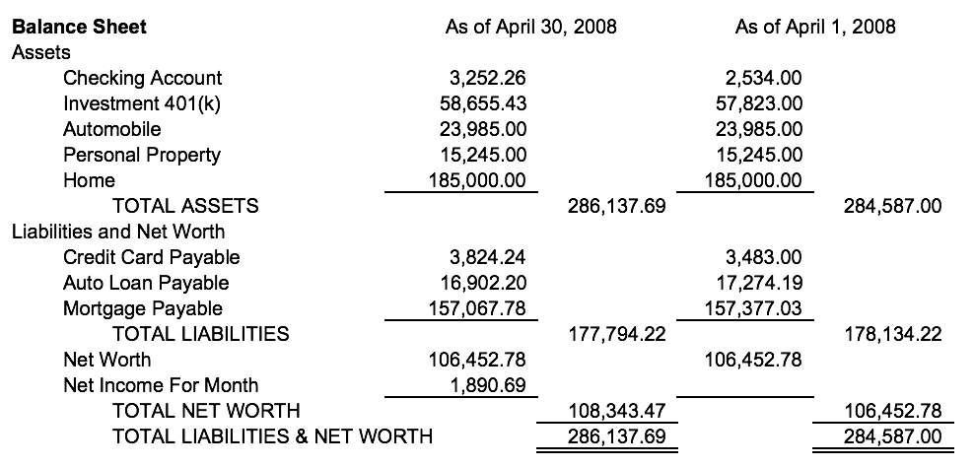

Slide 3
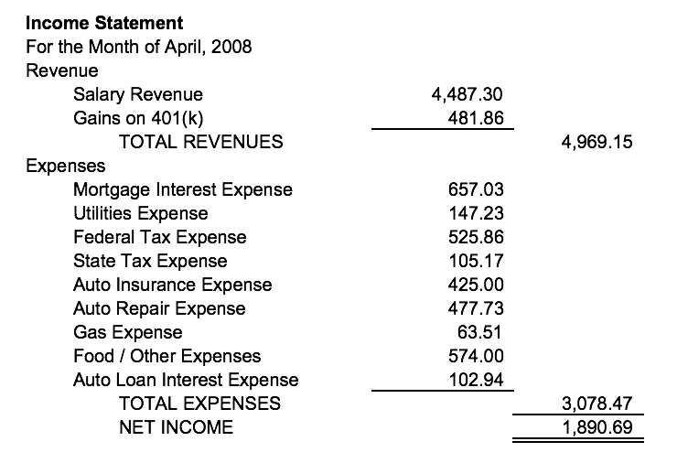

Slide 4
Conversations with Kip
Introduction to the
Income Statement
By Kip M. Twitchell

Slide 6
Conversations with Kip
Introduction to the
Accounting Cycle
By Kip M. Twitchell

Slide 7
Execute
Business
Event
Create
Journal
Entries
Post To
General
Ledger
Create
Trial
Balance
Create
Financial
Statements

Slide 8
Conversations with Kip
Accounting Cycle:
Create Journal Entries
By Kip M. Twitchell

Slide 9
Execute
Business
Event
Create
Journal
Entries
Post To
General
Ledger
Create
Trial
Balance
Create
Financial
Statements

Slide 10
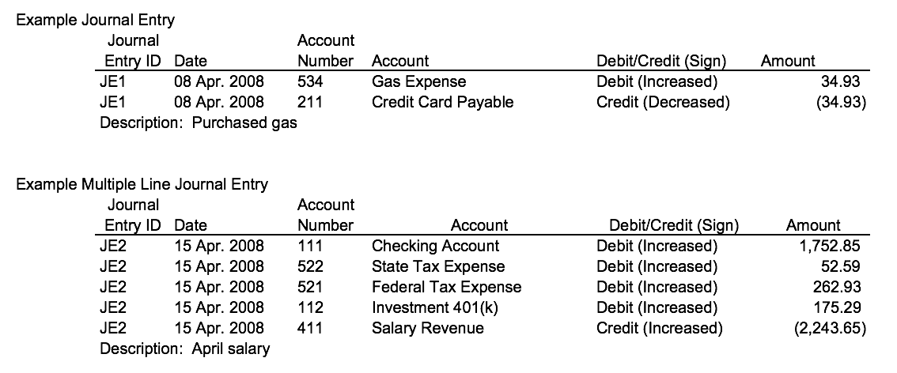

Slide 11
Conversations with Kip
Accounting Cycle:
Post to General Ledger
By Kip M. Twitchell

Slide 12
Execute
Business
Event
Create
Journal
Entries
Post To
General
Ledger
Create
Trial
Balance
Create
Financial
Statements

Slide 13
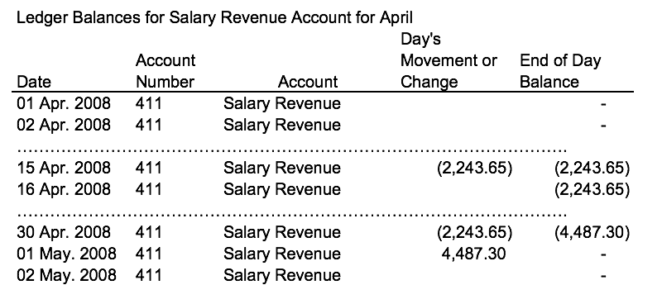

Slide 14
Conversations with Kip
Accounting Cycle:
Create Trial Balance
By Kip M. Twitchell

Slide 15
Execute
Business
Event
Create
Journal
Entries
Post To
General
Ledger
Create
Trial
Balance
Create
Financial
Statements

Slide 16
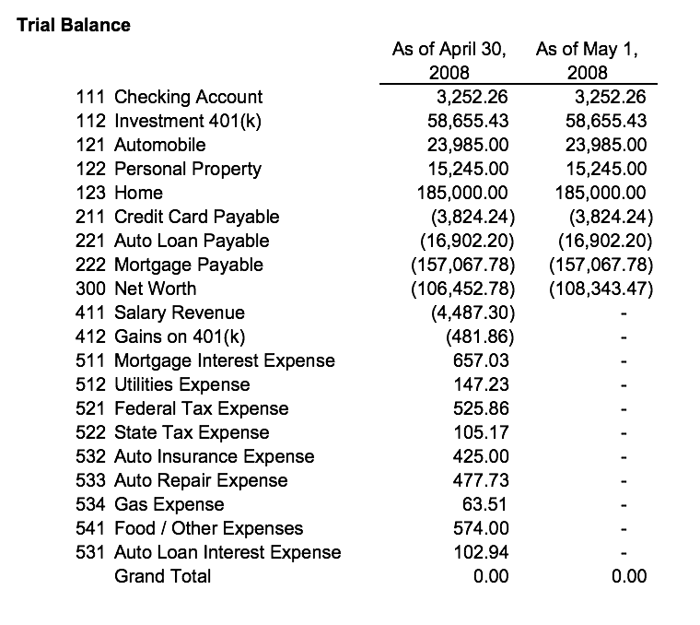

Slide 17
Conversations with Kip
Accounting Cycle:
Create Financial Statements
By Kip M. Twitchell

Slide 18
Execute
Business
Event
Create
Journal
Entries
Post To
General
Ledger
Create
Trial
Balance
Create
Financial
Statements

Slide 21
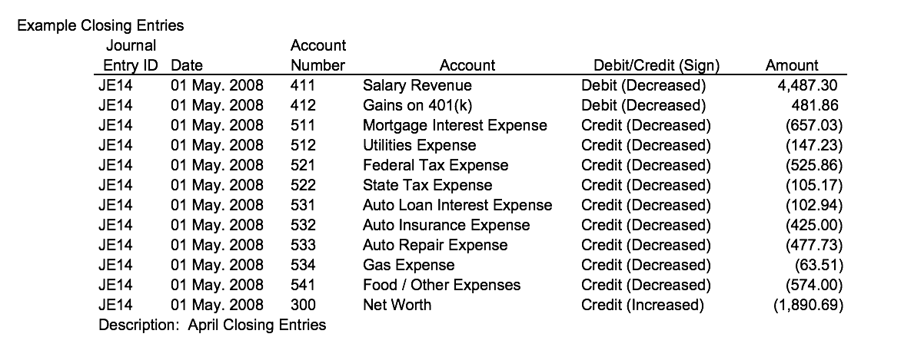

Slide 22
Conversations with Kip
© 2017 Kip M. Twitchell
All rights reserved

